Slide 1
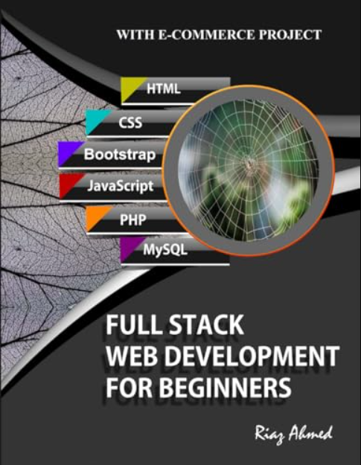
CS230 Tutorial --
Create a Full-Stack App with MongoDB
1- Review of Tutorial 1
2 - CORS Policy
3- Delete on Web Page
4- Update on Web Page
5- Backend - Express
Full Stack Web Development For Beginners:
Riaz Ahmed Amazon Digital Services LLC
– Kdp, 2021 ISBN: 9798738951268

Slide 2
1- Review of Tutorial 1
2 - CORS Policy
3- Delete on Web Page
4- Update on Web Page
5- Backend - Express

Slide 3
What we learned last Class?
1 – How to register MongoDB?
2 – How to connect with MongoDB?
3 – Create a Server to Realize CRUD.
4 – Use Postman to test Server Path.
5 – Use Web Page to Read and Create.

Slide 4

1- Project Architect – Only 3 Files
Backend
One Node.js File
Native HTTP Server
(Without Express)
Dependency: MongoDB
Frontend
HTML + JavaScript
CSS: Only 3 lines
AJAX - XMLHttpRequest
No Frontend Framework

Slide 5
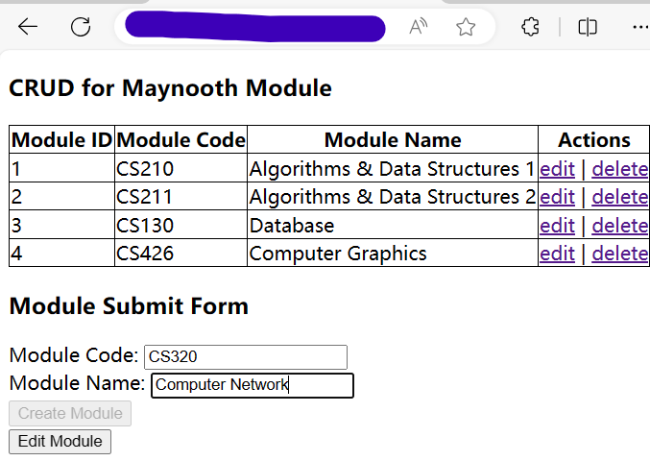

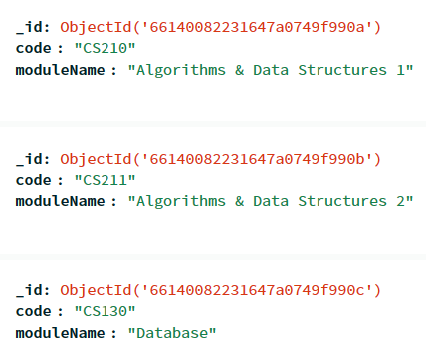
1- How Full Stack APP works?
13
Web Page
④
HTTP
Response
HTTP
Request
①
NodeJS
DB Query
Response
DB Query
Request
③
②
MongoDB

Slide 6
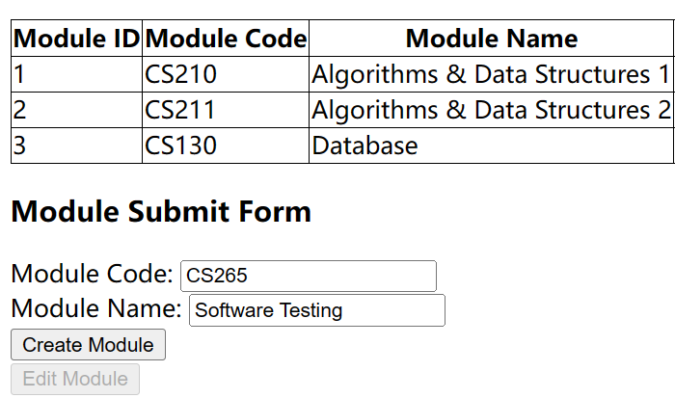

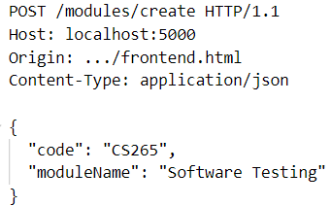
1- [Step 1] HTTP Request
When you Click the Button, the frontend part will send an XMLHttpRequest to the Browser. The browser create a HTTP POST Request and send it to the Server.
Web Browser
Send an XMLHttpRequest
HTTP POST Request
Web Page
Send an HTTP
POST Request
NodeJS

Slide 7
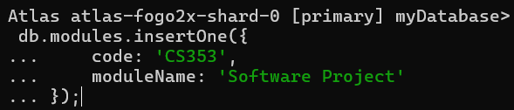

1- [Step 2] SQL Request
After receiving the HTTP POST Request from the Browser, the Server will check the Path and Request Type. If correct, the server will send a Query Request to the Database.
HTTP POST Request
Receive an
HTTP Request
NodeJS
Generate
Query
Database
Send Query Request to Database

Slide 8

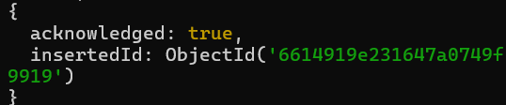
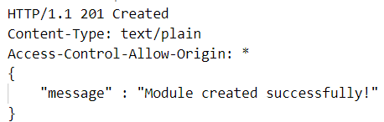
1- [Step 3] SQL Response
If Query Request is entered into the Database successfully, the Query Response will be sent to the Server without error. Then the Server will write HTTP Response Status Code and Body to the Browser.
Get Query Response
Database
Send to Server
No error
HTTP POST Response
Write Response
Head + Body
NodeJS
52

Slide 9
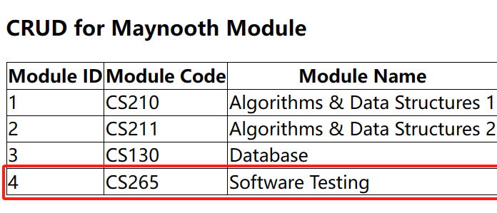
1- [Step 4] HTTP Response
After the Browser receive the HTTP Response, and the Status Code begins with 2(success response). The Frontend will refresh the table and show new Web Page.
HTTP POST Response
Web Browser
Send an HTTP Response
xhr.onload()
Status Code
Begins with 2
New Web Page
Page changes
Refrese Table

Slide 10

1- Realize CRUD for MongoDB
Step 1 – Use Mongosh to CRUD.
Step 2 – Use Postman to CRUD.
Step 3 – Use Web Page to CRUD.

Slide 11


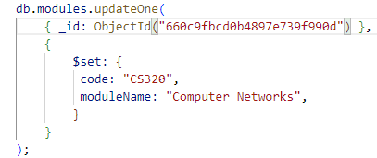

1 – MongoDB Methods - CRUD
[GET] - Get all Modules
[POST] - Create a Module:
[GET] - Get a Module:
[PUT] - Update a Module:
[DELETE] - Delete a Module:

Slide 12
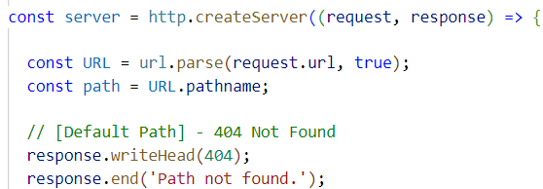
1 – Wrap Method in Server’s Path
[GET] - Get all Modules: localhost:5000/modules/get
[POST] - Create a Module: localhost:5000/modules/create
[GET] - Get a Module: localhost:5000/modules/get/:id
[PUT] - Update a Module: localhost:5000/modules/update/:id
[DELETE] - Delete a Module: localhost:5000/modules/delete/:id

Slide 13
1 – [Backend] Server Structure
Import Packages
19
Connect MongoDB
Configure Server
CORS Header
Node JS
Parse URL Path
Path for CRUD
Default Path
Listen to PORT

Slide 14
2 – Table Element
th | th | th | th | th
td | td | td | td | td
td | td | td | td | td
td | td | td | td | td
td | td | td | td | td
tr
thead
tr
tr
table
tbody
tr
tr

Slide 15
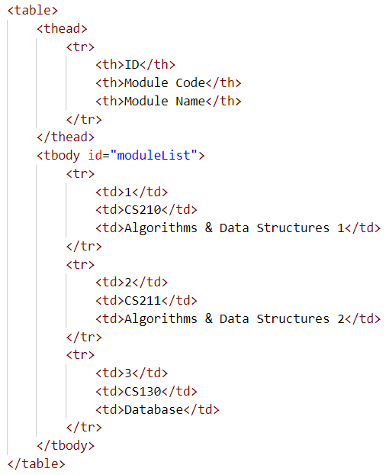
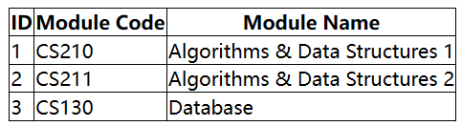
5 – Table Element

Slide 16
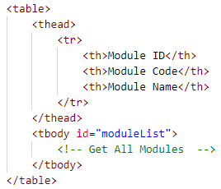
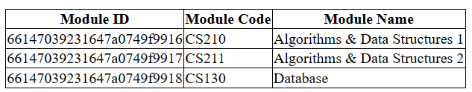
1 – [HTML] – Get All
HTML file
Fetch all Modules in XMLHttpRequest
Web Page

Slide 17
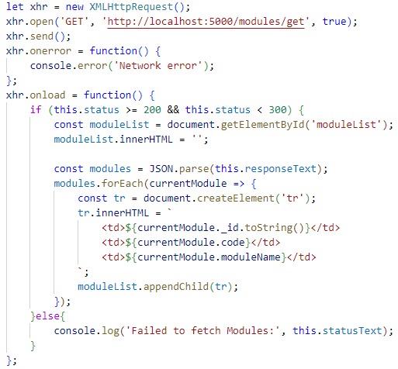
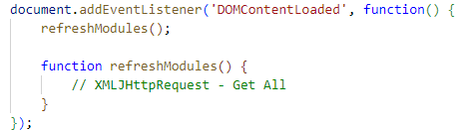
1 – [JavaScript] - Get All
Send an HTTP Get Request when Web Page is loaded

Slide 18
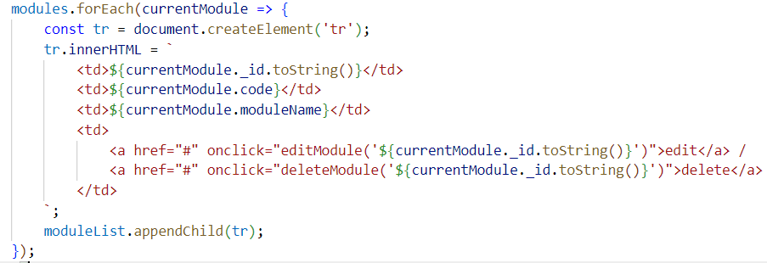
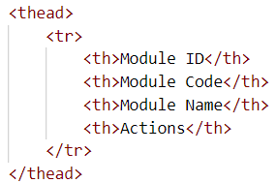
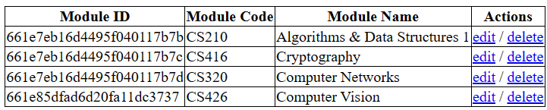
2 – [GET] Add a new Column

Slide 19

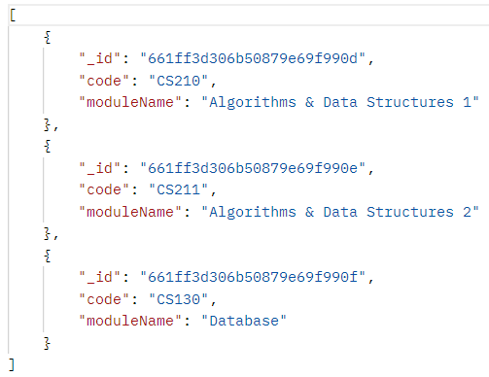
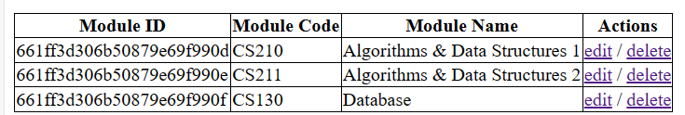
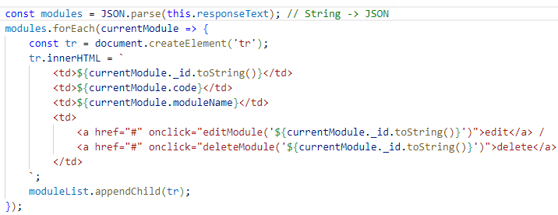
2 – [GET] XMLHttpRequest
[JSON] responseText
currentModule

Slide 20
1- Review of Tutorial 1
2 - CORS Policy
3- Delete on Web Page
4- Update on Web Page
5- Backend - Express

Slide 21
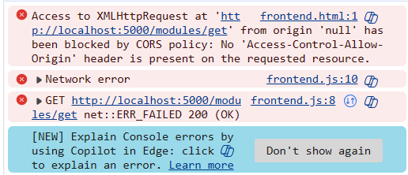
2 – CORS Policy
13
Why I get this Error?
You forget to set CORS Policy
in the Response Header !!!
CORS (Cross-Origin Resource Sharing)
For security reasons, when the URL of the Web Page and the Server are different, by default, the Server will reject the HTTP request of the Web Page.
In order to avoid this CORS error, we need to set a CORS Policy in the Response Header, so that we can relax these restrictions and allow Cross-Origin Resource Sharing.

Slide 22

2 – CORS Policy
Set Origin, Methods and Headers of CORS Policy in Response.
[OPTIONS] -> Preflight request
Prefligh request is part of the Cross-Origin Resource Sharing (CORS) Protocol. Before the Browser makes an HTTP request, the Browser will send a preflight request first, in order to confirm that the Server is Safe.

Slide 23
2 – What is Preflight?
Before the Browser makes a POST Request, the Browser will send a Preflight Request to the Server first. After the Server accepts the Cross-Origin Request, it will send a Preflight Response. Only if the Preflight Response is OK, the Browser can make a POST Request and get its Response.
③
POST Request
Preflight Request
①
Web Page
NodeJS
②
Preflight Response
④
POST Response

Slide 24
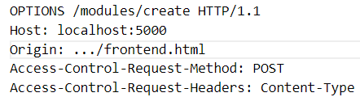
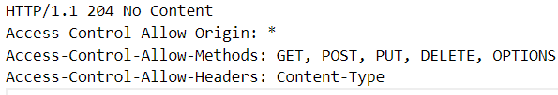
2 – Preflight Request and Response
[POST] - Create a Module: localhost:5000/modules/create
① Preflight Request
② Preflight Response

Slide 25
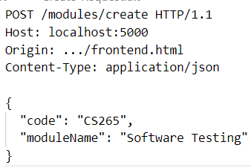
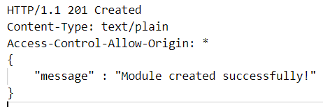
2 – Real POST Request and Response
[POST] - Create a Module: localhost:5000/modules/create
③ Real Post Request
④ Real Post Response

Slide 26
1- Review of Tutorial 1
2 - CORS Policy
3- Delete on Web Page
4- Update on Web Page
5- Backend - Express

Slide 27
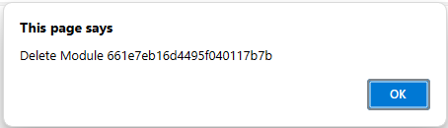
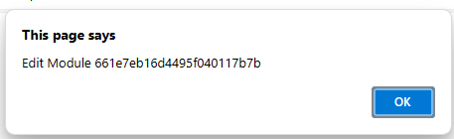
3 – Click Link then show ID

Slide 28
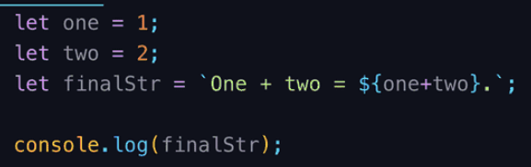

3 – Insert Variable in String
Using Backtick `, Dollar $ and Curly Bracket { }.
You can insert Variables in the String

Slide 29
3 – Action for Edit / Delete
Input Parameter
Hyperlink
When clicking the Hyperlink, invoke the function:
editModule(id) / deleteModule(id)
Let Hyperlink not change pages.

Slide 30
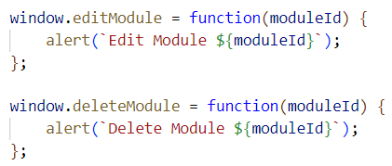
3 – Define the function of Link
Edit Module 661ff3d306b50879e69f990f
Delete Module 661ff3d306b50879e69f990f
Windows – Everywhere in the Brower, you invoked the function:
editModule/ deleteModule
The function of them will be:
function(moduleId) {
……
}

Slide 31
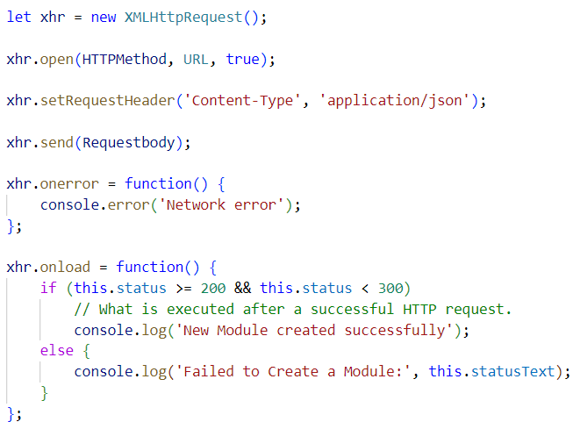
3 – [Frontend] XMLHttpRequest
Status Code begins with 2
(200, 201…)

Slide 32
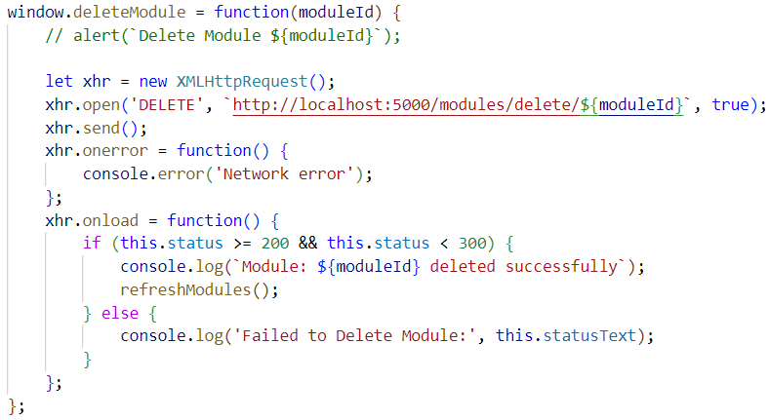
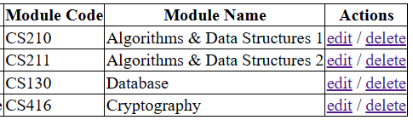
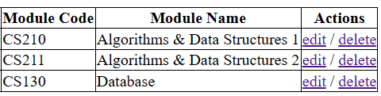
3 – [Delete] XMLHttpRequest
XMLHttpRequest - GET

Slide 33
1- Review of Tutorial 1
2 - CORS Policy
3- Delete on Web Page
4- Update on Web Page
5- Backend - Express

Slide 34
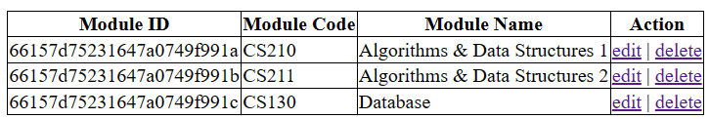
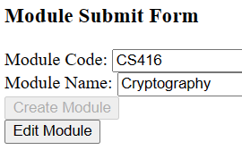
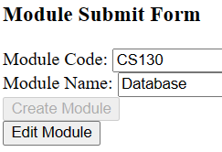
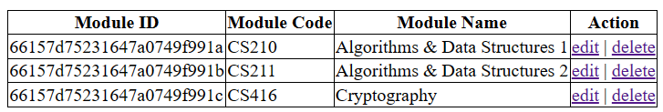
4 – How Update Works ?
id
[GET] - …/get/:id
Web Page
Refrese Table
[PUT] - …/update/:{currentId}
[GET] - …/get

Slide 35
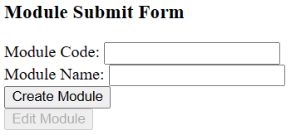
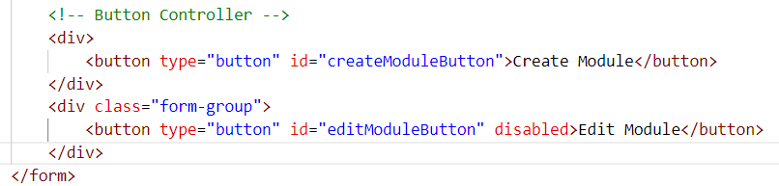

4 – Edit Button
disabled – cannot click the button.
Change the `disabled` property

Slide 36
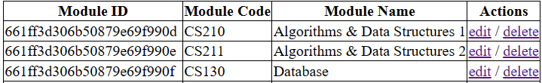


4 – Change Disable Property
Click `Edit` Action
Disable Create
Enable Edit
Enable Create
Disable Edit
Initial State
Click `Edit` Button

Slide 37
4 – Pass the Module Id
fetch current id
save
Click `Edit` Action
currentId
[GET] - …/get/ :id
Make sure only update the fetched id
[PUT] - …/update/:{currentId}
Click `Edit` Button

Slide 38





4 – Invoke function of Action and Button
fetch current id
[GET] – localhost:5000/modules/get/:moduleId
Click `Edit` Action
[Update] – localhost:5000/modules/update/:currentEditingModuleId
Click `Edit` Button

Slide 39
4 – [XMLHttpRequest] - Get All
Review the code
in last class
Send an HTTP Get Request when Web Page is loaded

Slide 40
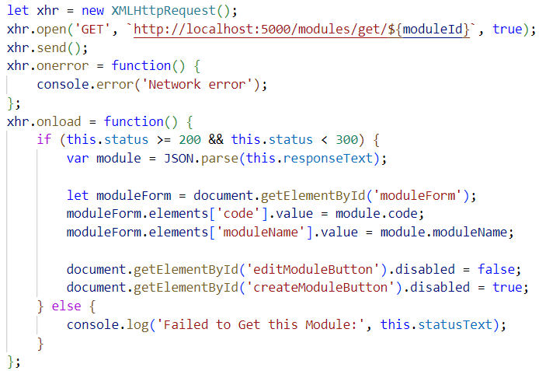
4 – [XMLHttpRequest] - Get One
fetch current id
fetch one module and render it on Form

Slide 41
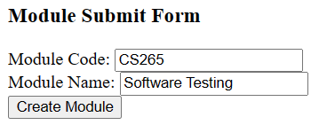
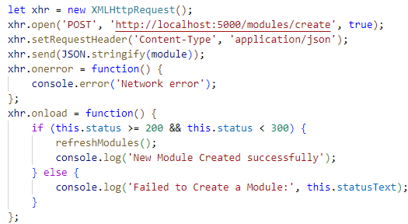
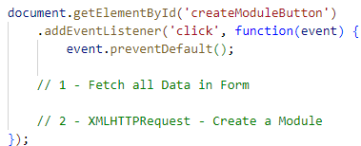
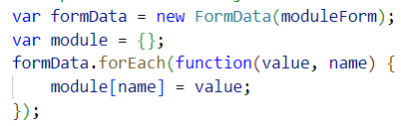
4 – [XMLHttpRequest] - Create One
Review the code in last class
Event Listener of Button Click
Request Body

Slide 42
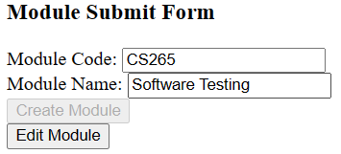
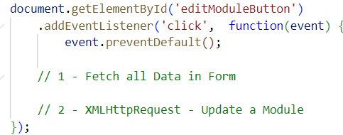

4 – [XMLHttpRequest]- Update One
XMLHttpRequest of Update
is very similar as Create
Event Listener of Button Click
Request Body
Get One

Slide 43
1- Review of Tutorial 1
2 - CORS Policy
3- Delete on Web Page
4- Update on Web Page
5- Backend - Express

Slide 44

5 – Express.js
Express is a NodeJS framework in Server that provides a very concise way to handle HTTP requests.
Before using Express framework, remember to install the relevant dependency, open Terminal and type:
npm install express cors
Offical Wesite: https://expressjs.com/

Slide 45


5 – CORS
Express can use only 2 lines to set CORS policy:
npm install express cors

Slide 46
5 – response.send()
Express can automatically set the Content-Type to be sent in Response.

Slide 47
5 – response.json()
Express can automatically send JSON Response, and
Express can automatically convert between JSON and String.
We don’t need JSON.stringify() or JSON.parse() anymore.

Slide 48

5 – express.json()
Express can automatically accumulate Request Body, and it can automatically convert between JSON and String.

Slide 49



5 – request.params.id
/modules/get/:moduleId
Express can parse the URL and get the URL’s dynamic parameters - `:moduleId`

Slide 50


5 – Express - Update
HTTP = 31 lines
Express = 13 lines
Express is more concise than HTTP !

Slide 51
5 – Express Example - Update
HTTP = 31 lines
Express = 13 lines
Express is more concise than HTTP !

Slide 52
5 – Structure of Express
Import Packages
Connect MongoDB
Create Express APP
Create
Read
Set Path for Express
Update
Delete
Default
Listen to PORT

Slide 53
5 – Structure of Express
1 – Import Package
const { MongoClient, ObjectId } = require('mongodb');
const express = require('express');
const cors = require('cors');
2 – Connect to MongoDB
const ATLAS_URI = “MongoDBConnectionString";
const client = new MongoClient(ATLAS_URI);
client.connect()
.then(() => console.log('Connected to MongoDB'))
.catch(() => console.log('Failed to connect'));

Slide 54
5 – Structure of Express
3 – Create Express APP
const app = express();
app.use(cors()); app.use(express.json());
4 – Set Path in Express
app.use((request, response) => {
response.status(404).send('Path not found.');
});
5 – Listen to the Port
const port = 5000;
app.listen(port, () => {
console.log(`Server running on port ${port}`);
});

Slide 55
5 – Template for Setting Path
Part 4 – Set Path in Express
app.get(`${URLpath}`, (request, response) => {
const objectId = new ObjectId(request.params.id);
mongoDBmethod
.then(results => {
response.json(results); // Option 1: GET
response.status(201).send('Success'); // Option 2: POST, PUT, DELETE
})
.catch(() => {
response.status(500).send('Error');
});
});

Slide 56

5 – Add 5 Path in Express
[GET] - Get all Modules: localhost:5000/modules/get
[POST] - Create a Module: localhost:5000/modules/create
[GET] - Get a Module: localhost:5000/modules/get/:id
[PUT] - Update a Module: localhost:5000/modules/update/:id
[DELETE] - Delete a Module: localhost:5000/modules/delete/:id

Slide 57



5 - Postman - Simulate HTTP Request
Register and download Postman at here:
https://www.postman.com/downloads/
Simulate the HTTP Request from the Web Page.

Slide 58


5 – Set Routes in Express
All path in moduleRoutes, will begin with `/modules`

Slide 59

5 – moduleRoutes.js

Slide 60

5 – moduleRoutes.js
Use `router` instead of `app`
Remove path `/modules`

Slide 61
What we learned this Class?
1 – How to register MongoDB?
2 – How to connect with MongoDB?
3 – Create a Server to Realize CRUD.
4 – Use Postman to test Server Path.
5 – Use Web Page to Read and Create.

Slide 62
The Plan for Next Class
1 – Try to Use Mongoose to Manage MongoDB at Backend.
2 – Use Axios Framework instead of XMLHttpRequest at Frontend.

Slide 63


My Contact Information
Microsoft Teams
wang.zhoukan.2022@mumail.ie
Email
Connect me on LinkedIn
https://www.linkedin.com/in/frenkie-wang-71ba0a1b5/
Don’t ask me any questions about your CS230 Assignments, I am not allowed to help you!!!

